Slide 1
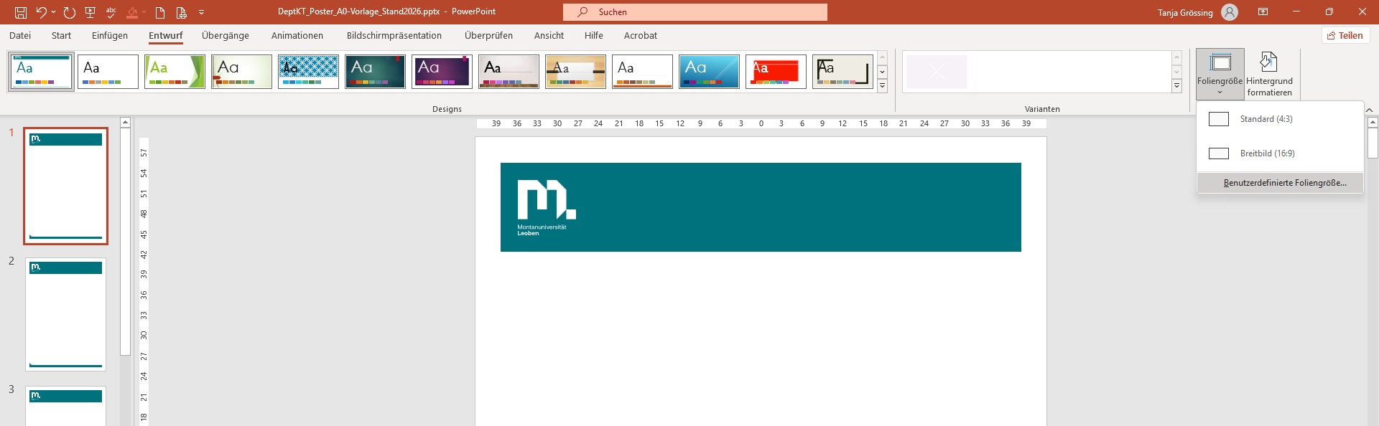
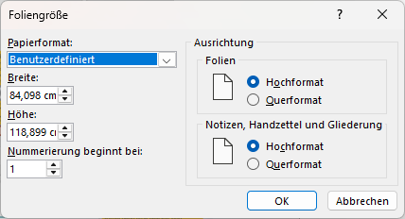
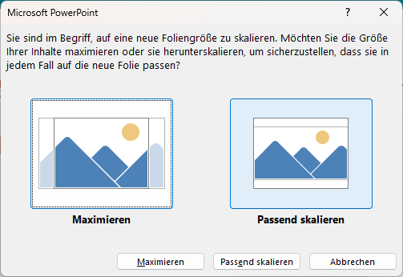


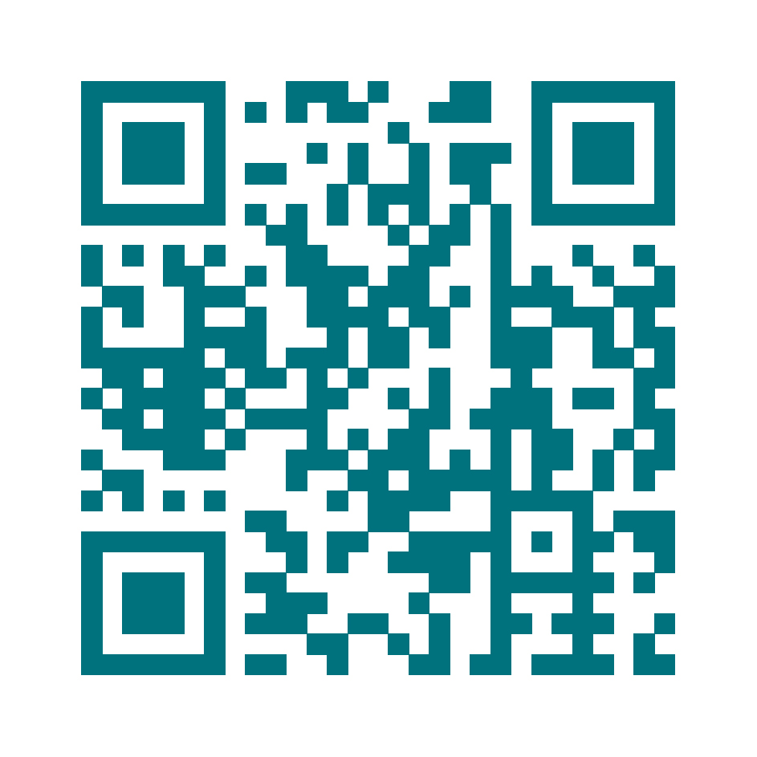
Notes on using
the poster template
Name¹, Name², Name³, Affiliation1, Affiliation2, Affiliation3
Before the design
This template is designed and optimized for A0. A proportional reduction is usually easy up to A1, up to A2 usually still easy to read - provided that the A0 poster is set "normally" and the smallest font sizes have been chosen sufficiently large. Scaling to A3 is borderline, A4 is usually too small.
Design → Slide Size → Custom Slide Size
Enter the desired width/height in cm → OK
Choose Scale to Fit (not Maximize) so that all design elements are scaled proportionally
Note: Ideally, the changeover is done before the template is filled.
Here is an overview of the
DIN dimensions
A4: 21.0 × 29.7 cm
A3: 29.7 × 42.0 cm
A2: 42.0 × 59.4 cm
A1: 59.4 × 84.1 cm
A0: 84.1 × 118.9 cm
Font sizes - Guidelines
1.
2.
3.
4.
5.
John Doe
Insitute of ….
max.mustermann@unileoben.ac.at
Research Focus: quias as quianimagnia quias as quianimagnia quias as quianimagnia
Project: Olut et quia volupta dolorem
Project Partners: Olut et quia volupta Funding: Olut et quia volupta dolorem
Contact Information

Slide 2
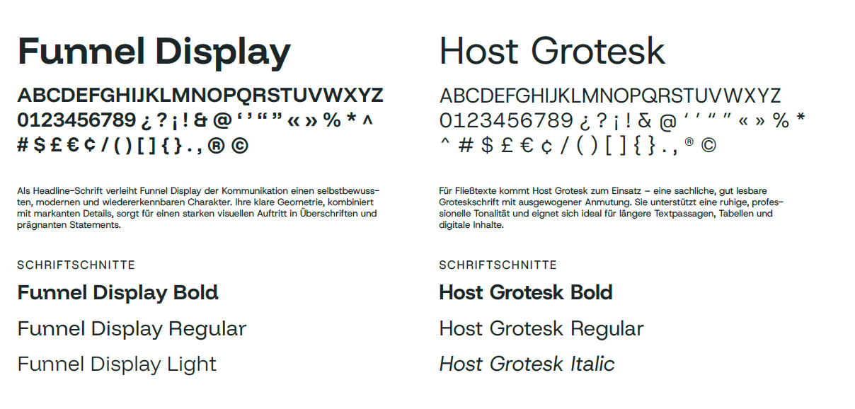
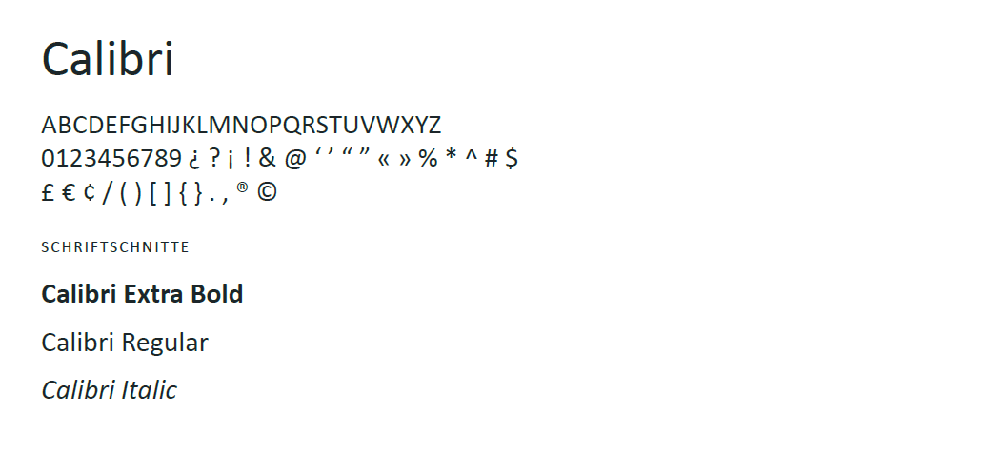
Poster Design Checklist
Layout and Grid
Use white space: generous margins (at least 15–25 mm), do not "squeeze" elements.
Alignment: Choose the alignment to match the content and stay consistent within a document. As a rule, the following applies: continuous text is left-aligned; Figures, measured values and table contents preferably right-aligned or tabular.
Typography
Line length: 45–75 characters; Line spacing 120–140%.
No "light/thin" cuts for small sizes; sufficient contrast (black/dark grey on light).
Max. 2 font families; Use font style – i.e. bold, italics, etc. – sparingly.
  MUL Font Families
Colors and contrast
1 primary color + 1–2 accent colors; consistent color mapping in graphics. Feel free to use the MUL 2025 color scheme built into this template
or use the color codes from the MUL Brandbook
Accessibility: high brightness contrasts; Red/Green is not the only distinguishing feature.
Leave background calm and bright; Don't overlay blocks of text over complex images.
Images and graphics
Resolution: 200-300 ppi in final size (no upscaling).
Diagrams: clear axes, easy-to-read scales, meaningful units; Legends close to the data.
Lines/lines: at least 0.5 pt (printing), grids/net lines very discreet or omitted.
Icons sparingly, only for navigation/visualization.
Data Visualization
Choose the simplest suitable shape: bars > cakes; Avoid gradients and 3D.
Colors consistent between charts; same order in legend and graphic.
Error bars, n-information, sources/methods briefly.
QR codes and contact
Final size: 25-30 mm edge length; enough white border.
Destination URL short/speakable; Test QR before printing.
Practice quick checks before submission
100% view on the screen: is the smallest text easy to read?
Test print in A3/A4: contrast, diagram readability, test QR code.
Outer edges: nothing "sticks" to the edge; Baselines and edges neatly aligned.
Consistency: equal units, decimal separators, color values, legends.
Brand fonts
Alternative font

